Slide 1


NAP on Chemical Safety and Security Management in Malaysia: Components, Strategies, Implementation Mechanism, Risk Communication and KPI’s
Raja Subramaniam, PhD
Undersecretary
National Authority for Chemical Weapons Convention Malaysia
Notes:
This presentation provides an overview of chemical safety and security management initiative undertaken by Malaysia in their capacity to mitigate the risks arising from chemical accident, potential misuse of toxic chemicals including the threat of terrorism.

Slide 2
Outlines
Definitions
Introduction – Chemical Management in Malaysia
NAP - Chemical Safety
NAP - Chemical Security

Slide 3
Definition (Ref: : https://www.opcw.org/)
Chemical safety
- measures to prevent non-deliberate releases of toxic chemicals into the environment and to mitigate the impact if such events occur.
- comprises disciplines such as occupational safety, public safety, process safety, environment safety, consumer safety and transport safety.
Chemical security
- measures to prevent deliberate releases of toxic chemicals and to mitigate the impact if such events occur.
- it also includes policies to prevent attempts to acquire toxic chemicals or chemical weapons precursors.
Notes:
I think it’s easy to be diverted from this topic due to broad definition of both chemical safety and security.
Chemical safety and security referred to measures taken at the governmental and private enterprises to ensure chemistry is practiced in safe and secure manner.
Chemical safety – non deliberate releases
Chemical security – deliberate releases
In this context, Malaysia has implemented substantial measures in relation to chemical safety and security although gaps do exists.

Slide 4
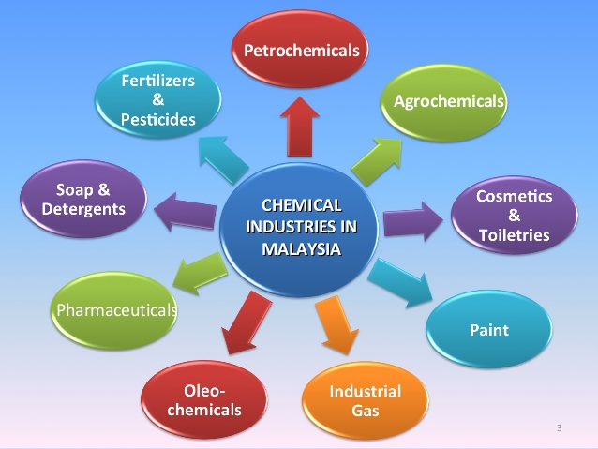
Malaysia – very vibrant chemical industry
6% of GDP
Main sectors – oleochemicals and petrochemicals
Larger chem. industries represent larger risk
Huge challenge to govern chemical safety/security
Chemical safety and security in Malaysia – self regulated
Most initiatives from industry itself

Slide 5
Chemical life cycles – 5 components
To manage these components, Malaysia has been focusing on cradle to grave type management
Recently, cradle to cradle which is more sustainable
Emphasizing on 3R, zero product defects, JIT manufacturing, continual process improvement, use of renewable energy

Slide 6
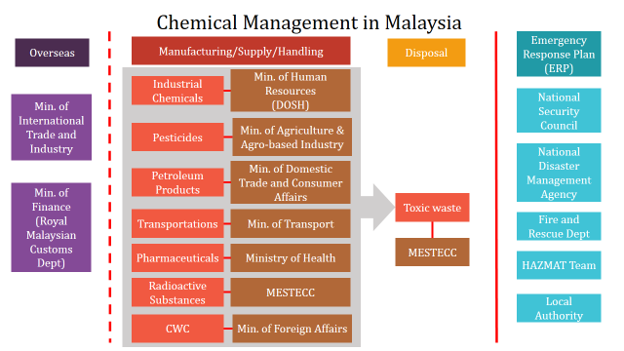
LEGISLATIVE COVERAGE FOR CHEMICAL SAFETY AND SECURITY
CRADLE TO GRAVE
IMPORT/EXPORT CONTROL
INCLUDE ERP – TERRORISM / DISASTER MGMT
9 GOVERNMENT AGENCIES
Notes:
A strong and comprehensive legal framework provides the basic needs to govern chemical safety and security.

Slide 7
Current Progress in Chemical Management in Malaysia
Actively participated in various international events (P61 EU CBRN CoE, SAICM, APEC Chemical Dialogue and Chemical Working Groups);
Important committees were formed:
Environmentally Hazardous Substances Steering Committee (EHSSC)
National Coordinating Committee on implementation of Global Harmonized System
Pesticides Board Meeting
National Mercury Steering Committee
Central database:
•online EHS Notification and registration scheme as a voluntary basis;
•CIMS online systems for chemical safety at workplace as a mandatory scheme;
Pesticides Registration by Pesticides Board
Risk assessment:
•Chemical Health Risk Assessment by Department of Occupational Safety and Health
National Hazard mapping
National Risk Register
Notes:
SAICM – strategic approach to international chemicals management – a global policy framework to foster sound management of chemicals. Hosted by UN Environmental Programme.

Slide 8
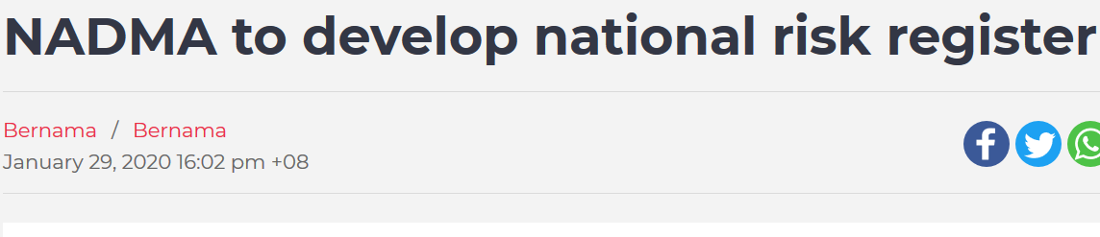
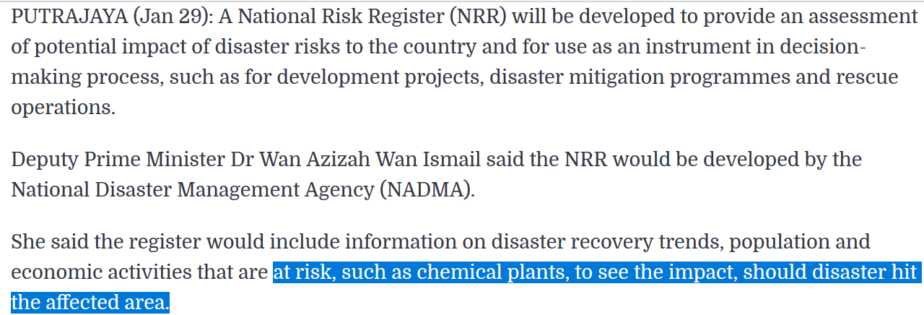
Notes:
Latest – Malaysia to develop national risk register which include chemical plants

Slide 9
Current Progress in Chemical Management in Malaysia
Hazard communication – implemented Global Harmonized System (GHS) Classification System for registration of imports , transportation and safe handling of chemicals and hazardous substances; and
Training modules–EiMas under Dept of Environment and Malaysian Technical Cooperation Programme has developed few training modules for chemicals management

Slide 10
Current Challenges / Gaps - Chemical Safety and Security Management
Too many chemicals substances and products put into market without any knowledge of its risk
Continued use of chemicals with dangerous properties such as carcinogen, mutagens and reproductive toxicants as there is no knowledge of its risks
Lack of awareness on safe and sustainable way of managing chemicals
Lack of skills, knowledge and manpower
Lack of comprehensive security mechanism solution for dual purpose chemicals
Limited chemicals data and inventory
Inadequate financial resources
Notes:
CAS number – 158 million unique organic and inorganic substances not including products
Continued use motivated by cost, effectiveness, greed and lack of green alternatives
Awareness lacking especially among the SME and consumers
Rohan have a comprehensive presentation on human factor due to lack of skill and knowledge
Security management comes with additional cost to industry
Big data management is the way forward in managing crisis nowadays and Malaysia is also looking into having a comprehensive and real time data
Financial limitation particularly on chemical safety and security which has no direct benefit to industries

Slide 11
CHEMICAL SAFETY

Slide 12
Development of National Action Plan on Chemical Management
9th Malaysian Plan
(2006-2010)
10th Malaysian Plan
(2011-2015)
11th Malaysian Plan
(2016-2020)
GHS
Incentive to Industries
3R related technologies
Address indiscriminate use of toxic chemicals in agriculture
Focus on waste management
5 strategies proposed to strengthen and integrate chemical management framework system in Malaysia
Notes:
Our NAP in chemical safety is represented in our 5 years Malaysian development plan known as MDP.
Chemical management has been an essential part of MDP since 1967.
It has been a progression with ultimate goal of sustainable development goals by 2025 meaning a substantial use of chemicals is essential to meet the social and economic goals of the world community, with a high degree of safety when best practices are followed
Currently we are at 11th MDP covering year 2015-2020 which focuses on 5 strategies.
3R = reduce, reuse and recycle

Slide 14
Action plan for Chemical Management
STRATEGY 1 | ACTION PLAN
Mainstream Chemical management as part of the National development planning | Incorporate chemical management in 11th Malaysian Plan Develop funding mechanism to promote and sustain chemical management
Notes:
Funding is essential to promote and sustain chemical management. Having chemical management as an agenda of the 11th MDP allows access to resource including funding. It also reflects strong government commitment in chemical management.

Slide 15
Notes:
I stated that at least 9 government agencies enforcing at least 9 acts on chemical safety and security. Overlapping and duplication of functions, roles and activities can be observed. Strategy 2 looks into one stop centre, a Lean and mean organization structure as well as streamlining all acts under one roof is the way forward.

Slide 16
Notes:
Still remain as proposal due to cost of such integration.

Slide 17
Notes:
Big data give access to information during crisis management and policy decision. Having a real time integrated and comprehensive inventory of chemical and waste will provide the required big data.

Slide 18
Action plan for Chemical Management
STRATEGY 4 | ACTION PLAN
Promoting Chemical Risk Assessment | Develop criteria for chemical risks assessment
Notes:
Risk assessment – Malaysia has embarked on risk / hazard mapping and latest national risk register which is part of chemical risk assessment. This strategy is also relates to strategy 3.

Slide 19
Notes:
Every single personnel which involved in chemical safety need to continuously trained. Malaysia through DOSH introduced CEP point system for those competent personnel including safety officer to maintain their competency
On capacity building on chemical incident mitigation, Malaysia currently focuses on mass casualties management and medical response

Slide 20
CHEMICAL SECURITY

Slide 21
Gaps
No specific NAP on chemical security
No specific legislation directly related/ regulate chemical security
Need to identify which agency will take the lead

Slide 22
Current progress in Chemical Security
Existing laws on chemical security
    - STA 2010
    - CWC Act Malaysia 2005
    - Explosive Act 1957
Vehicles carrying Dangerous Good Rules 2015
Responsible care, 7th code on chemical security
Notes:
STA 2010 – control on transit, transhipment and importation of dual use goods.
CWC Act Malaysia has incorporated verification regime to monitor movement of schedule chemicals and inspection of industries
The Explosives Act 1957 is a Malaysian laws which enacted relating to the manufacture, use, sale, storage, transport, import and export of explosives.
Vehicles carrying DG is the latest laws that covers both chemical security and safety
RC -A voluntary commitment by global chemical industry to drive continuous improvement and achieve excellence in environmental, health and safety, transport and security performance. Malaysia has a strong representation in RC.

Slide 23
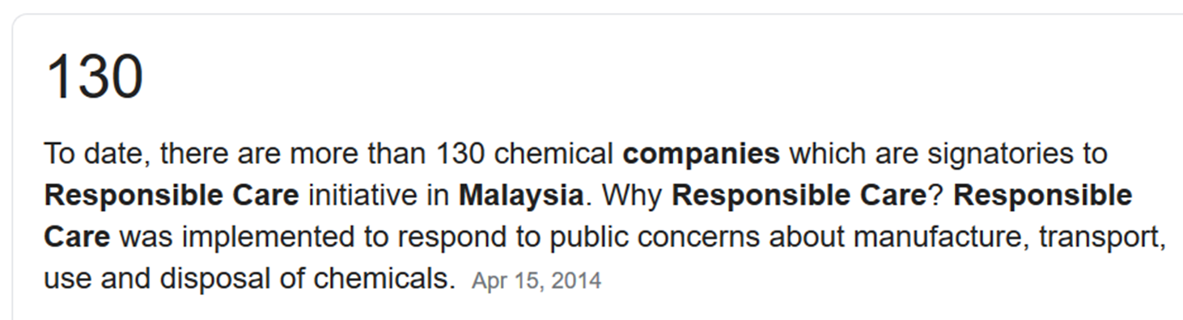
1994
RC launched in Malaysia
1994-99
Guiding Principles / 6 codes/ self assessment format
2000
Indicators of Performance
2010
RC Mgmt System
2017 Security code launched
2002
RC Awards
Notes:
A voluntary commitment by global chemical industry to drive continuous improvement and achieve excellence in environmental, health and safety, transport and security performance.

Slide 24
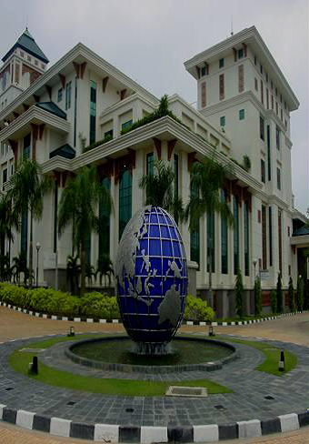
THANK YOU

